Slide 1









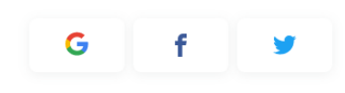




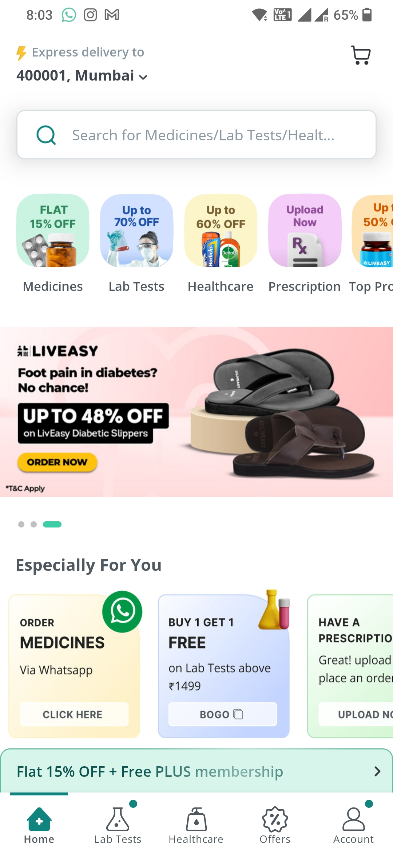
Deliver to
06103, Hartford
Deliver to
06103, Hartford
Sign Up or Login
Choose your Location
Search for Hospital/Medicines
Search for Hospital/Medicines
Email/Phone
Enter Zip Code
Check
Set Current Location
Send OTP
Medicines
Lab Tests
Disease Prediction
Self Medication Videos
or
Beds
Hospitals
Insurance
Insurance Claim
Login Screen
Location Reader Page
Home Page 1
Home Page 2

Slide 2


Deliver to
06103, Hartford
Deliver to
06103, Hartford
First Name
Insurance Policy
Last Name
Premium Amount
Date of Birth
PROCEED TO PAYMENT
Contact
E-mail
REGISTER AND PROCEED
Insurance 1
Insurance 2

Slide 3
Deliver to
06103, Hartford
Deliver to
06103, Hartford
Deliver to
06103, Hartford
View my Policy
Renew
View my Policy
Renew
Insurance Policy
Sudhanshu Malik
Sudhanshu Malik
ISO Silver - 123456789
ISO Silver - 123456789
ISO Silver - 123456789
Premium Amount
Premium
Due Date
Premium
Due Date
$500
$500
07/27/2023
$500
07/27/2023
SUGGESTED POLICIES
PROCEED TO PAYMENT
Blue Cross Shield Advantage
RENEW
Aetna Health Fund
VIEW MORE PLANS
UnitedHealthcare Choice
Cigna Connect
Kaiser Permanente HMO
VIEW MORE PLANS
Insurance 3
Insurance 4
Insurance 5

Slide 4
Deliver to
06103, Hartford
Hospital Name
Hospital Address
Date of Admission
Date of Discharge
Reason of Hospitalization
SUBMIT
Insurance Claim

